Slide 1
Cloud DevOps
PaulStack
LynnLangit

Slide 2
World-wide Cloud Usage

Slide 3

Reality

Slide 4
Compute and Data
Docker/Containers
Data Warehousing

Slide 5
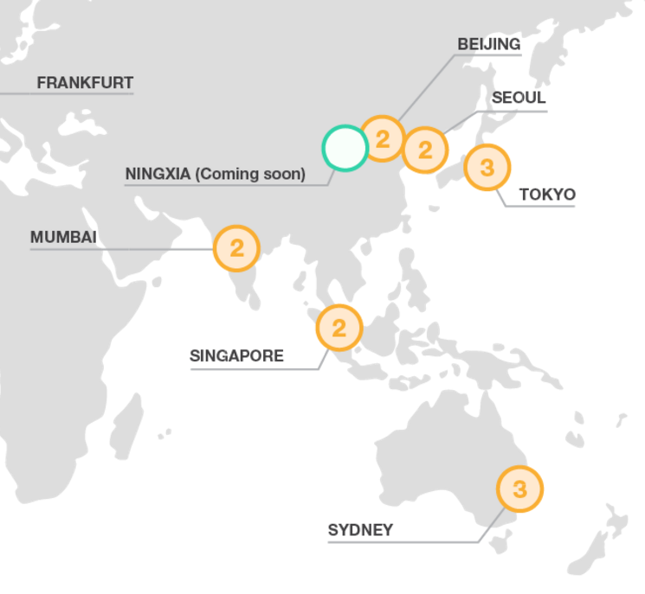

Regions – AWS & Azure

Slide 6
Demo
AWS Containers

Slide 7
Demo
Azure Containers

Slide 8
Demo
AWS Data Warehouse

Slide 9
Demo
SQL Server on Docker

Slide 10

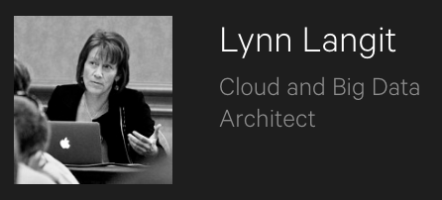
Learn More
From Lynn Langit

